Slide 1

ask.in
Med-fi Prototype 2
Team Larry the Porcupine
Sean Chang, Grace Zhao, Melinda Wang,
Ari Qayumi & Vrinda Vasavada

Slide 2





Our Team
Sean C
Melinda W
Vrinda V
Grace Z
Ari Q

Slide 3
Table of Contents
01
02
Problem and Solution
Usability Study
03
04
Insights and Design Revisions
What’s Next

Slide 4

Problem and
Solution

Slide 5
Problem Overview
Young adults need a trustworthy source of health insurance education.

Slide 6
Mission Statement
Value Proposition
Increase the health insurance literacy of young adults who are navigating healthcare for the first time.
A community to help you navigate your lifelong healthcare journey.

Slide 7
Solution Overview
A health insurance forum, with hassle-free insurance detail extraction and optimal organization of feedback from peers and experts

Slide 8
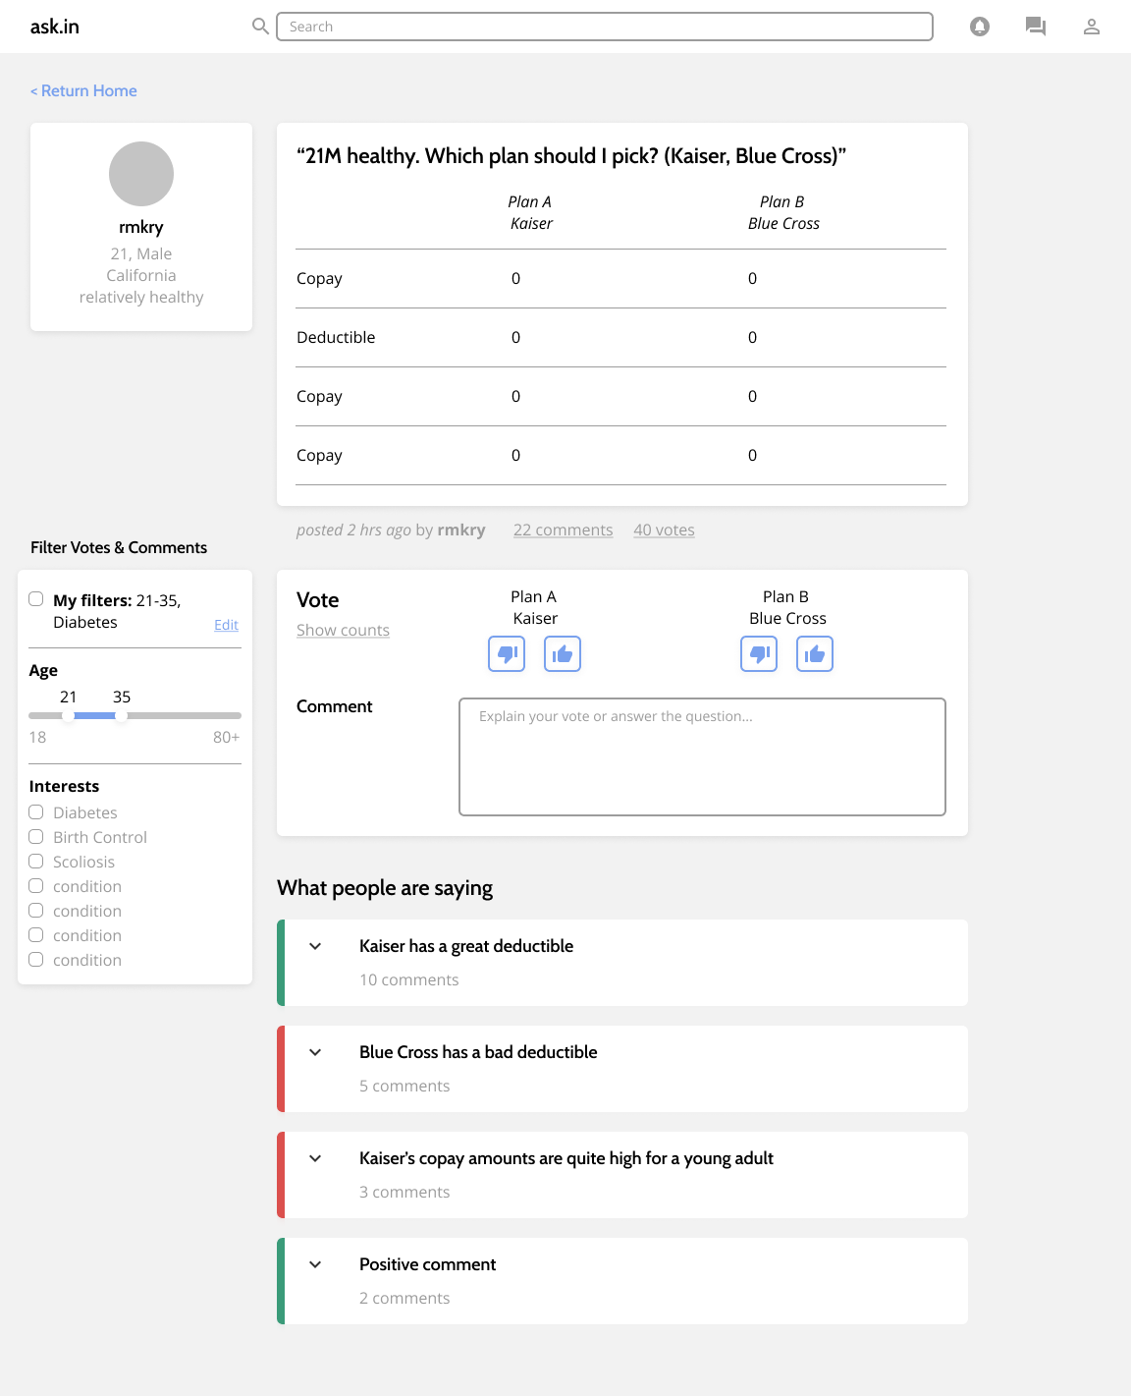
Redesign 1
Goal: Improve visual hierarchy

Slide 9
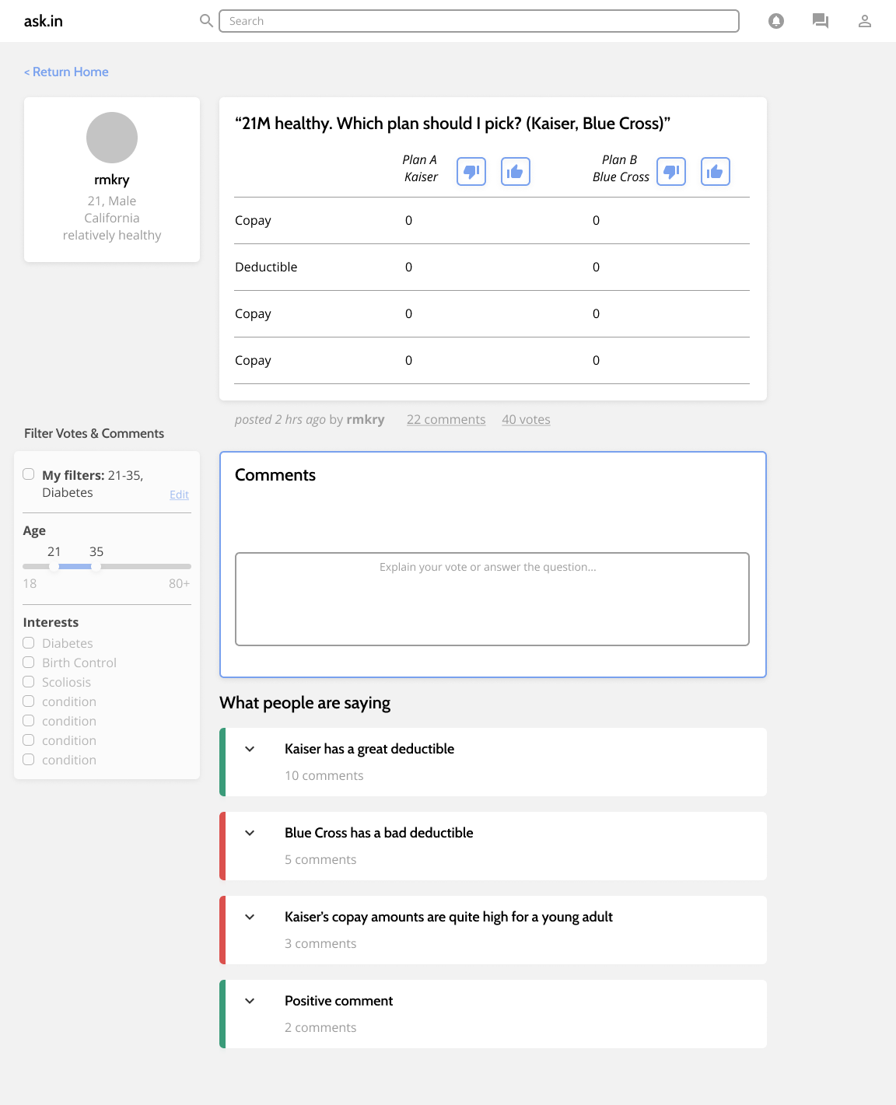
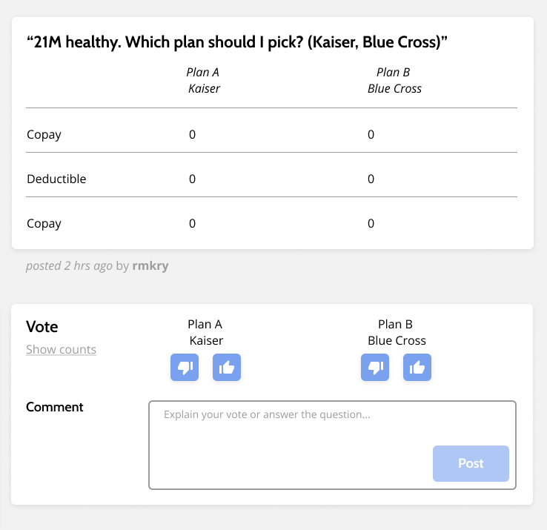
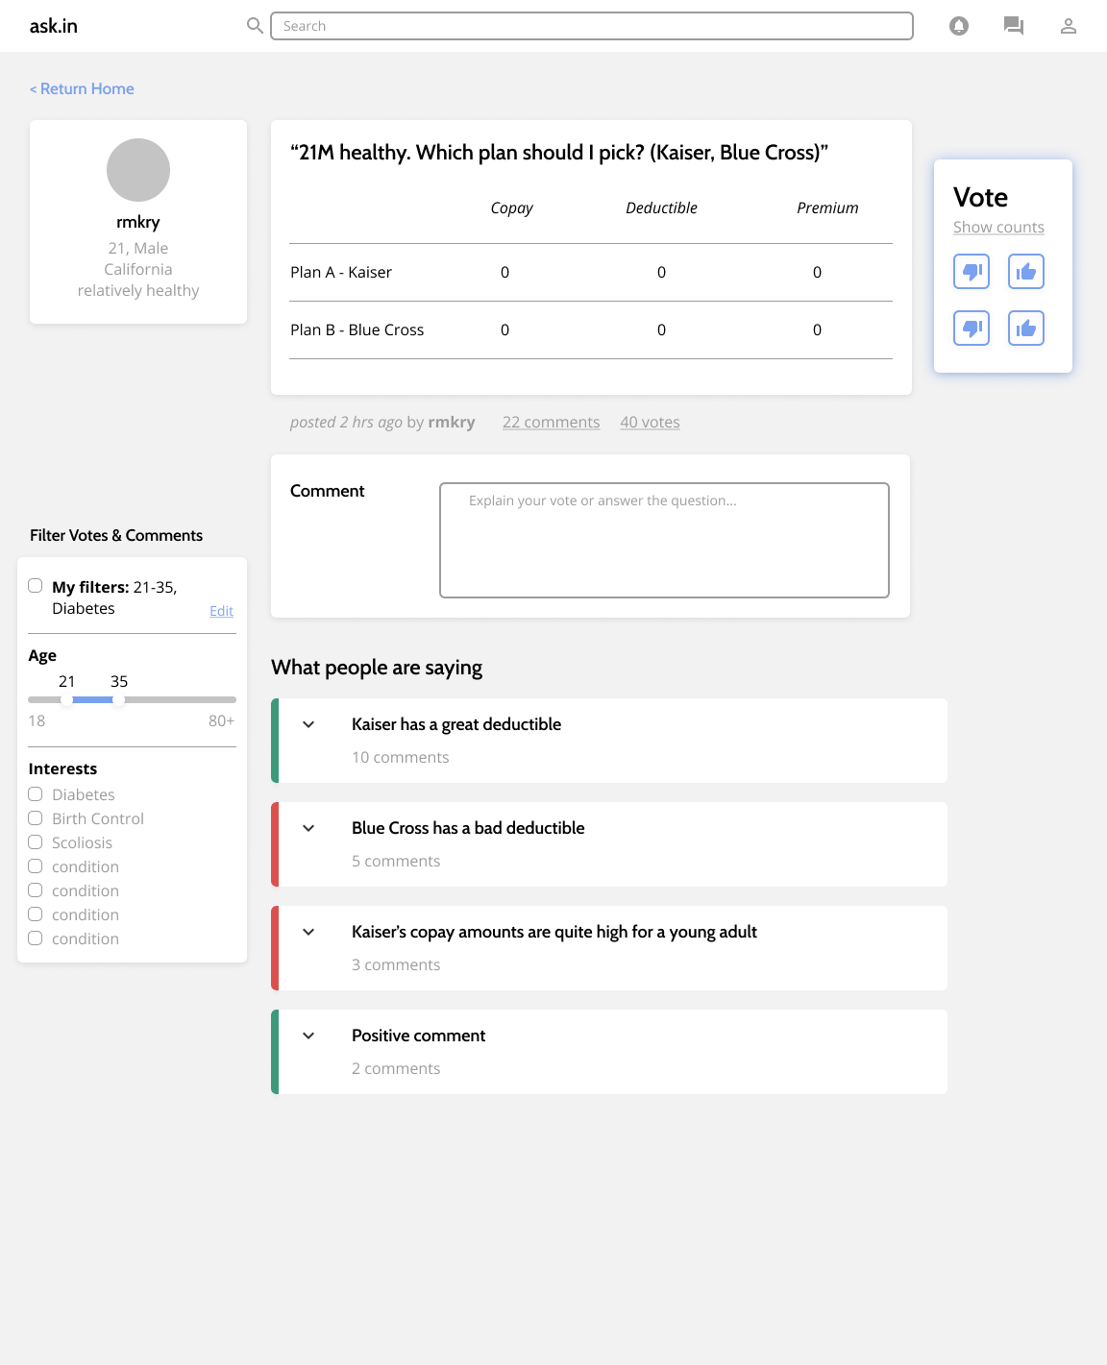
Redesign 1 - Voting Options
1 - Put voting in the table
2 - Separate voting and commenting
3 - Original format, but increase button contrast

Slide 10
Usability Study

Slide 11
Study goals
Gather consensus on the redesigned voting options
Test 3 tasks to find usability issues
See what content/functionality we provide is most useful or lacking

Slide 12
Study Participants
Insurance Types
Forum Usage
Technology Usage
Employment Status
Healthcare knowledge
Industry
5 interviewees

Slide 13
Insights and Design Revisions

Slide 14
Usability Testing Results
 | User 1 | User 2 | User 3 | User 4 | User 5
Ask a Question
Comment and Vote on a Question
View Feedback
Notes:
Why was user one yellow? → confusion on home page (lack of experience w forum website)

Slide 15
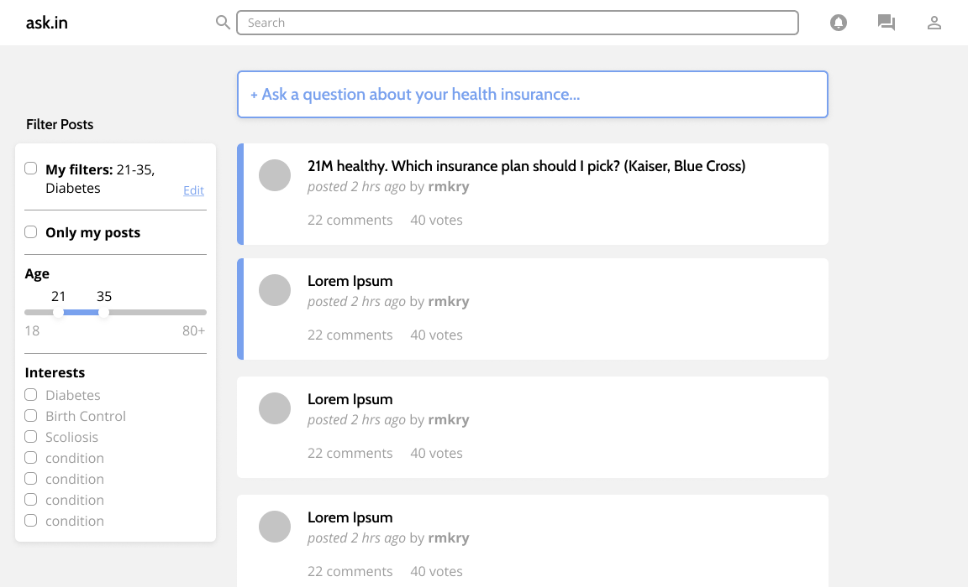
Finding 1: Visual Design
1
2
3
4
Design Revisions
Users want friendlier colors
“I would like to see a little more color. It’s just very neutral right now.”

Slide 16
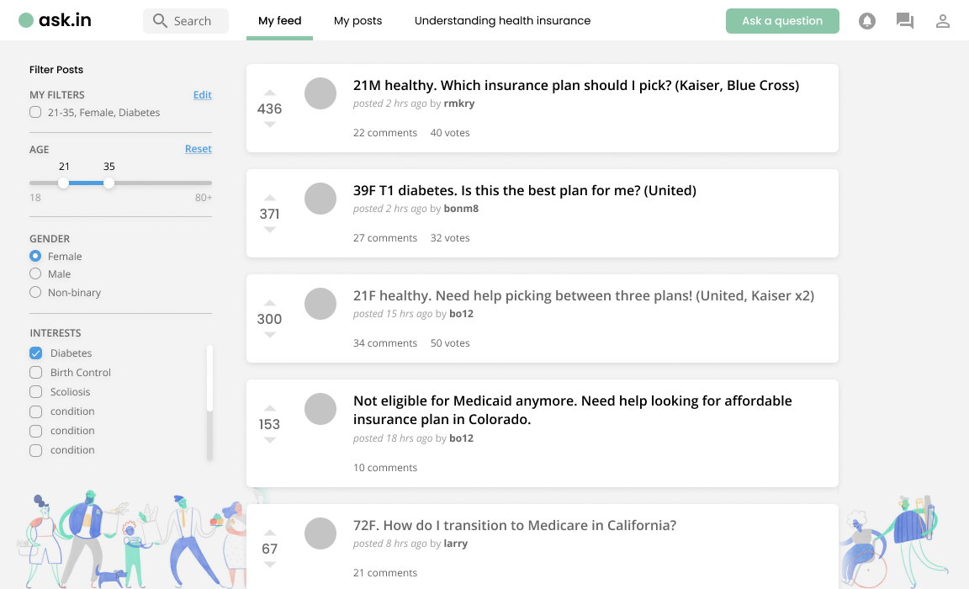
Revision 1: Revamping Visual Design
1
2
3
4
Design Revisions
Illustrations and rounder fonts

Slide 17
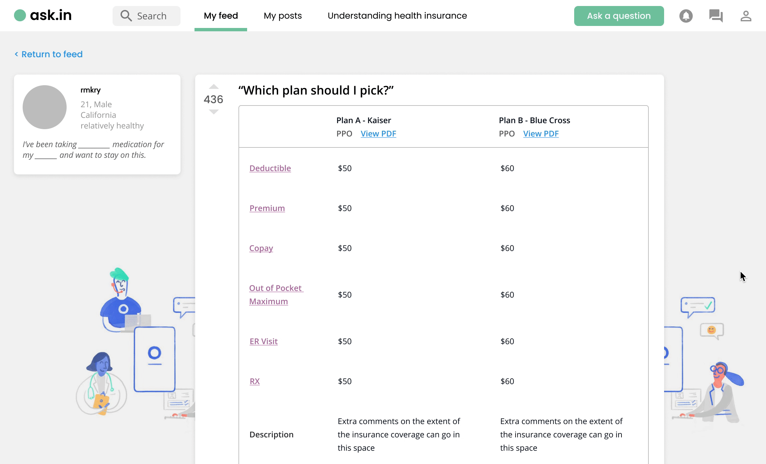
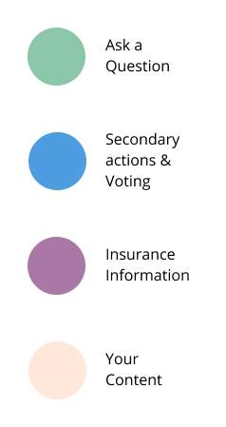
Revision 1: Revamping Visual Design
1
2
3
4
Design Revisions

Slide 18
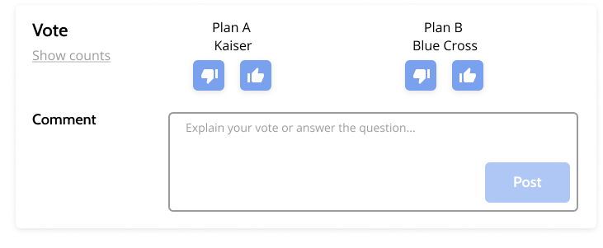
Finding 2: Clarifying Voting
1
2
3
4
Design Revisions
General confusion about being able to vote for both insurance options
“I think it would be better if it was an either-or situation”

Slide 19
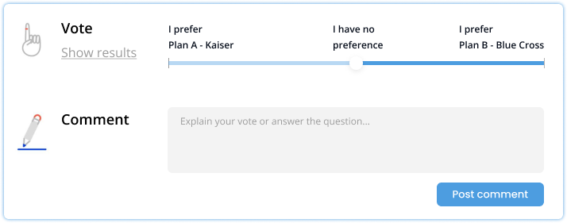
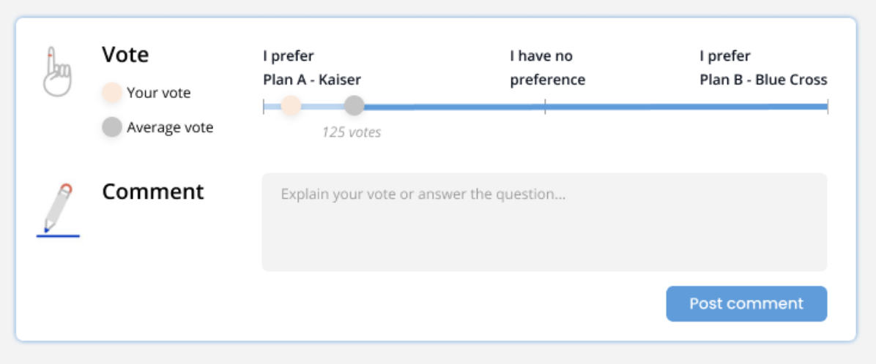
Revision 2: Clarifying Voting
1
2
3
4
Design Revisions
Sliding scale
Comparison between average and your vote

Slide 20
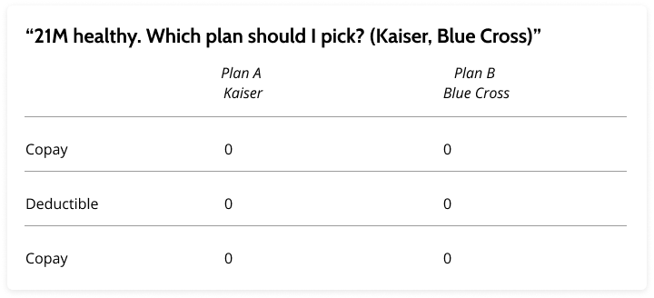
Finding 3: Displaying the Insurance Plan
1
2
3
4
Design Revisions
Information in insurance plans is not always tabular
“Insurance plans are too complicated to be summed up in a few numbers like this”

Slide 21
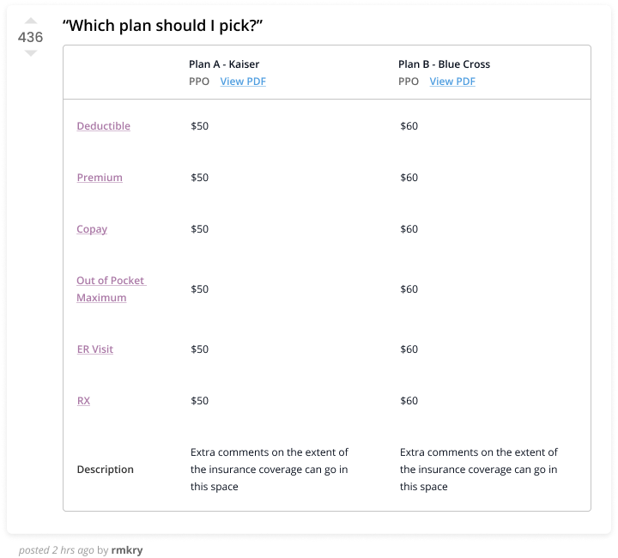
Revision 3: Displaying the Insurance Plan
1
2
3
4
Design Revisions
Optional PDF attachment
Space for additional descriptions at the bottom of the column

Slide 22
Revision 4: Improving Navigation
1
2
3
4
Design Revisions
Need to change navigation to incorporate a “How to understand my insurance” section

Slide 23
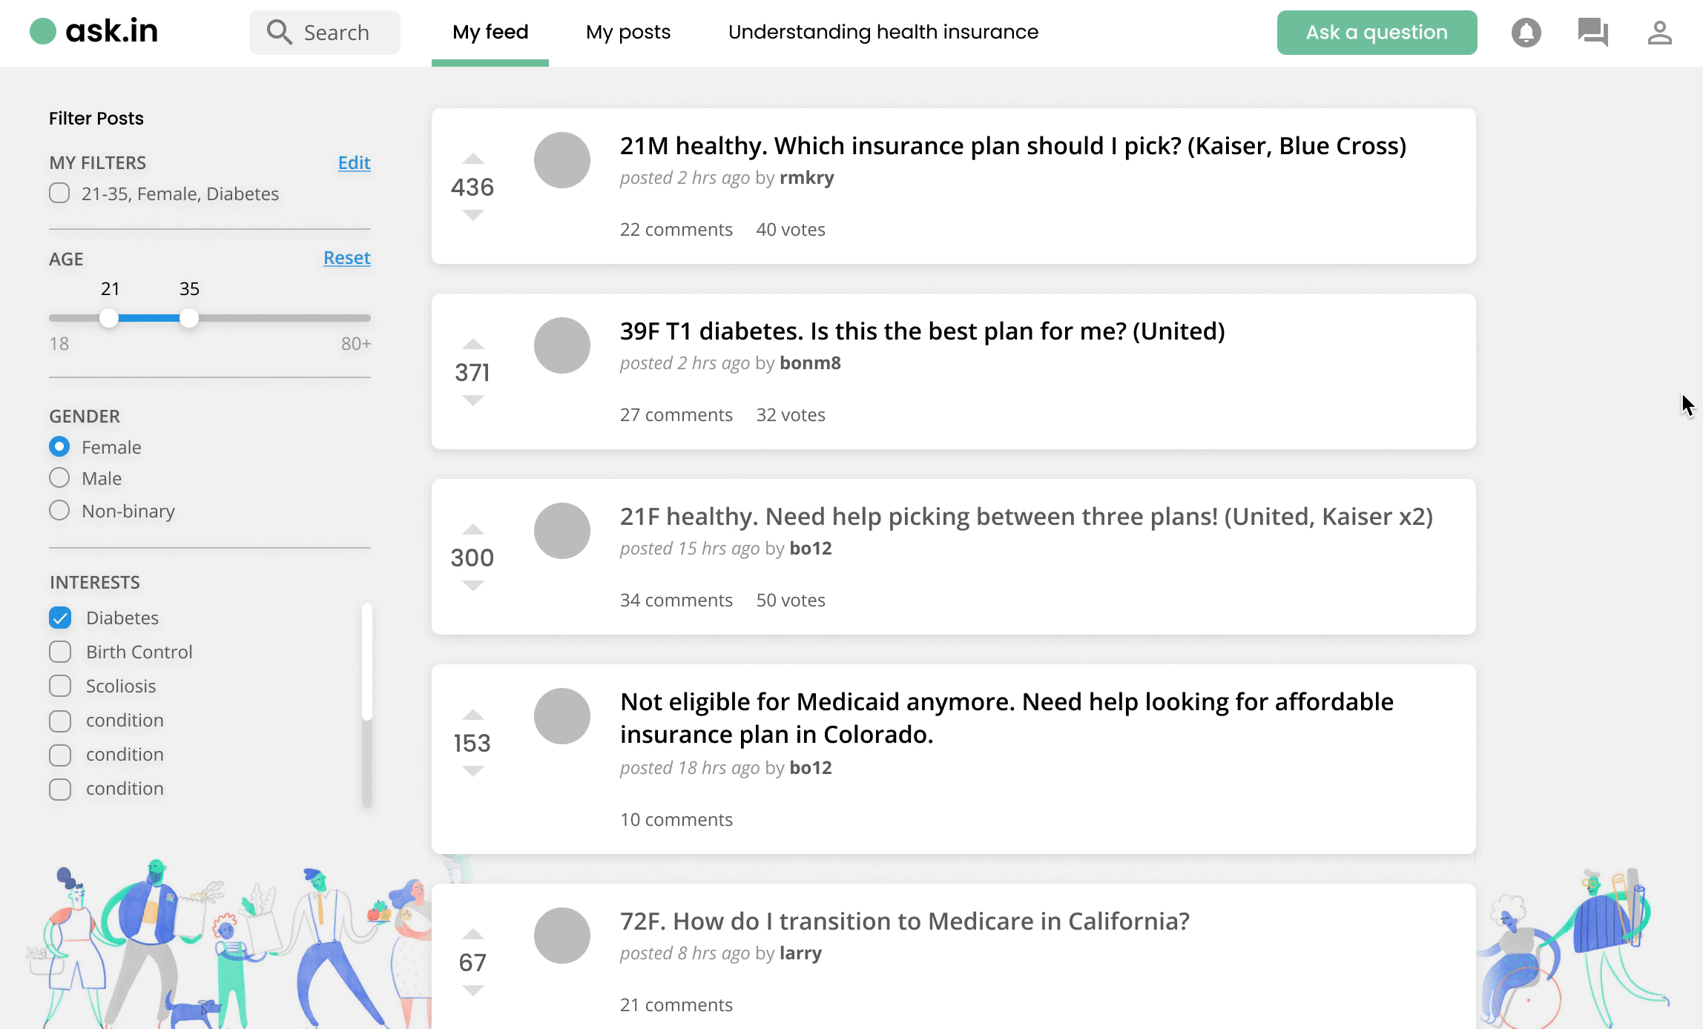
Revision 4: Improving Navigation
1
2
3
4
Design Revisions
Introduction of navigation bar
Ask a question as a modal

Slide 24
What’s Next

Slide 25
What’s Smart About ask.in?
Automatic Insurance Detail Extraction
Smart Comment Groups
Smart Tagging of Keywords + Definition Links
Automatic Profile-based Fields for Posts
Notes:
Automatic Insurance Detail Extraction: Our AI will parse insurance documents for relevant values and fields that we can collect for users
Smart Comment Groups: We will use AI to group together similar comments to prevent users from being overwhelmed by too many comments on a single post
Smart Tagging/Definition Links: We plan to use AI to identify keywords and add links to definitions for posts to help users on the spot define confusing terms
Automatic Profile-based Fields: After inputting your personal information, we hope to use AI to determine what fields ask.in recommends you to include on each post based on what other users have found useful

Slide 26
Next Steps
2) “How to understand my insurance” page
3) Find insurance plan by Policy Number
1) Profile creation

Slide 27
Thank you!
Any Questions?

Slide 28
Appendix

Slide 29
Prototype Links
Redesign 1: https://www.figma.com/file/DSgazxvGULbbsE81VnX8qs/377E-Health-Insurance-Education?node-id=322%3A5114
Redesign 2: https://www.figma.com/file/DSgazxvGULbbsE81VnX8qs/377E-Health-Insurance-Education?node-id=422%3A215

